Slide 1
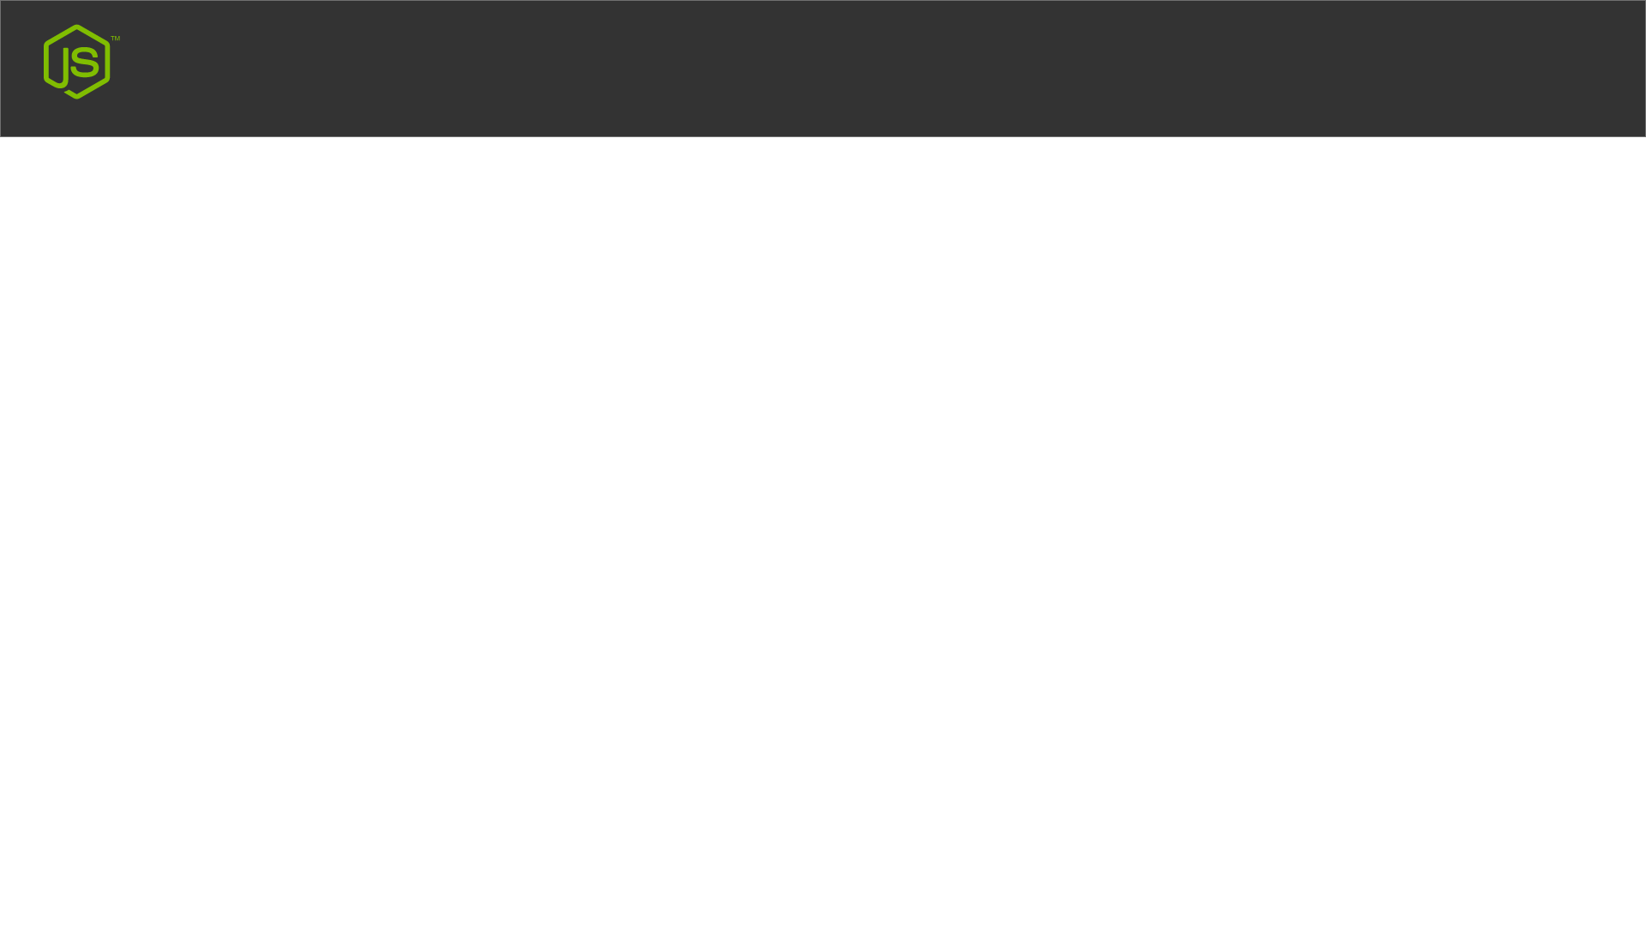

Node.js Http Module
My First Node Server Run Hello World

